Slide 1
Mapping Anime Genres
Terry Drinkwater
Class: Digital Humanities 100
Instructor: Adam Anderson

Slide 2
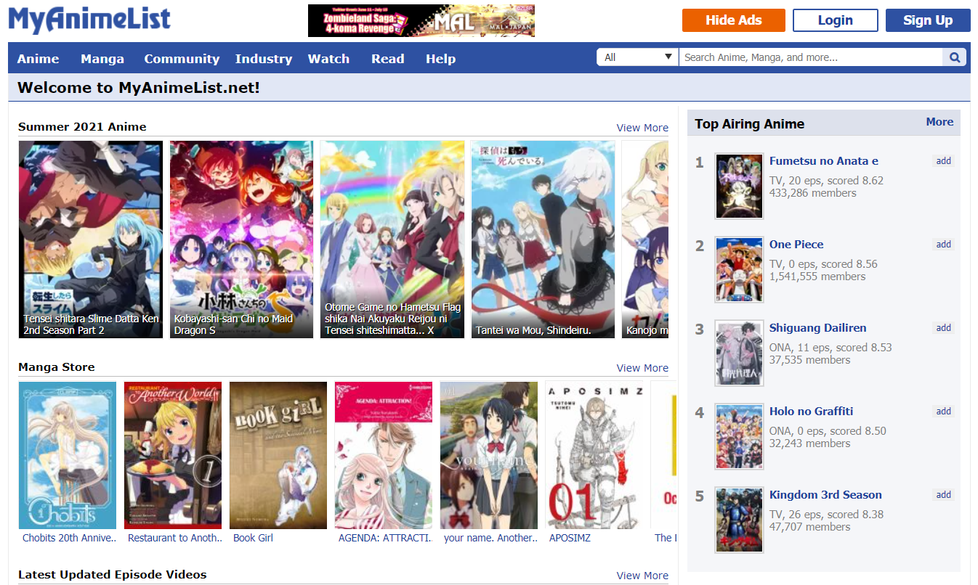
Database: MyAnimeList

Slide 3
Database: MyAnimeList...indirectly
Snapshot of database in 2018 collected as Kaggle dataset by user Azathoth
Dataset size:
Filtering: removing users without metadata
Sampling: 1500 random TV shows (out of ~4600 total)
 | Raw | Filtered | Sampled
Users | 300k | 115k | 115k
Media | 14,478 | 14,474 | 1500
User-Media Records | 80m | 21m | 7.6m

Slide 4
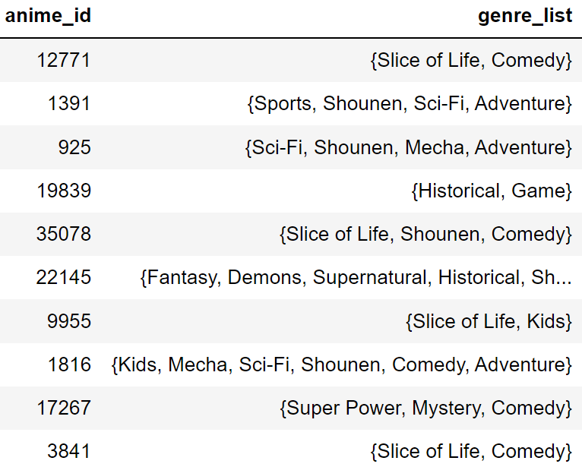
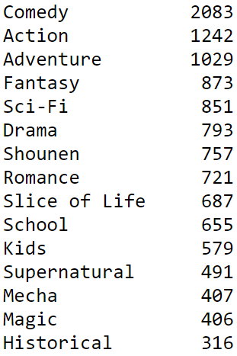
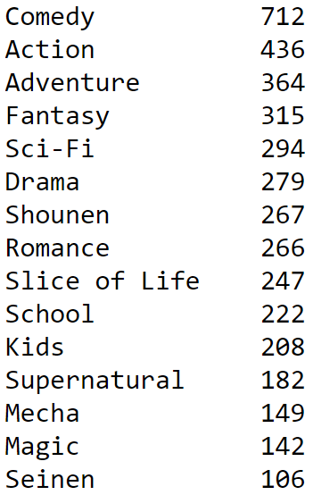
Genre Tagging: Multiplicity Makes Categorization Difficult
By Title
Top 15 Genres in Data...
...and in Sample
Total Genres: 40

Slide 5
Measuring Genre Similarity
First take: Number of shared genres
Issue: what if rare genres are drowned out?

Slide 6
Measuring Genre Similarity
First take: Number of shared genres
Issue: what if rare genres are drowned out?
Second take: Shared genres, weighted by rarity
Issue: to what degree should they be weighted?

Slide 7
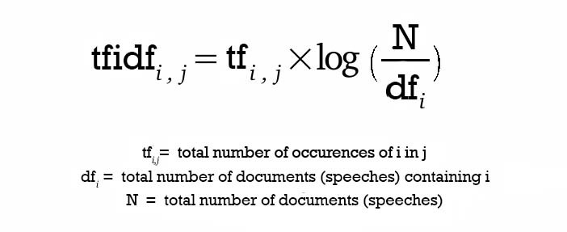
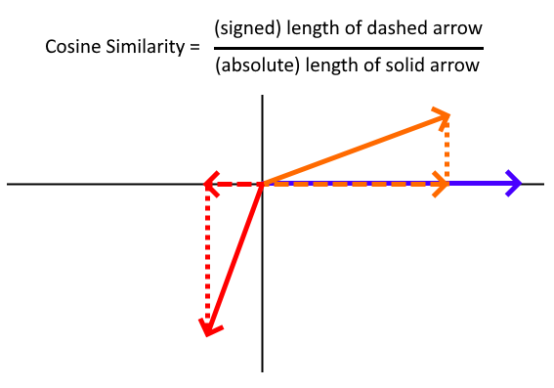
Measuring Genre Similarity
Third take: ...Oh, someone probably already tried this
Term Frequency-Inverse Document Frequency
Weight genres by inverse log-rarity
Cosine similarity between genre vectors

Slide 8
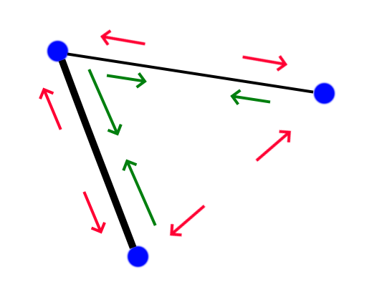
Visualizing Genre Similarity: Force-Directed Graphs
Arrange the nodes randomly
Simultaneously:
Nodes with shared edges attract each other
All nodes repel each other
Repeat with diminishing effect
Attractive force can vary by edge weight

Slide 9
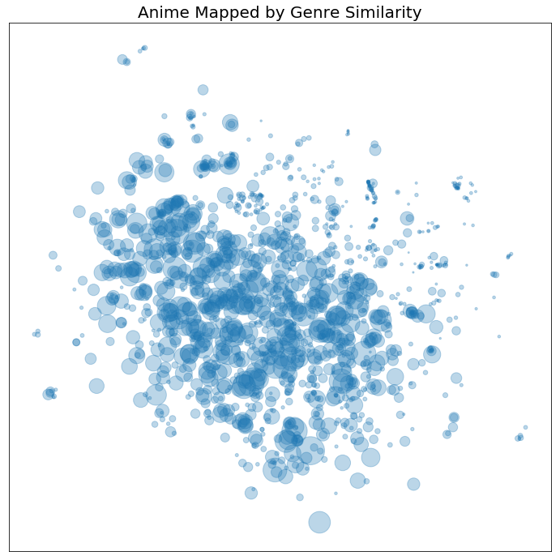
The Map
Node size: # of people who have interacted with the show

Slide 10
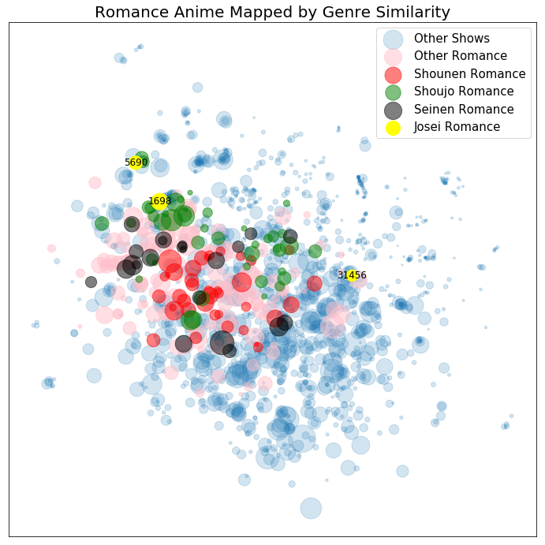
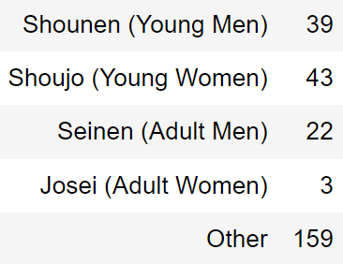
Example Genre: Romance
Major genre concentrated to one side
Sub-genres occupy different areas within the major genre
Sub-genres are not necessarily cohesive

Slide 11
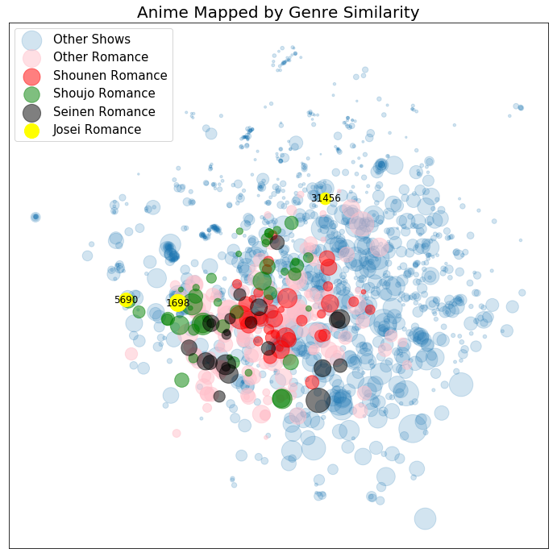
Evaluation: Robustness
What happens if we change the initial node randomization?

Slide 12
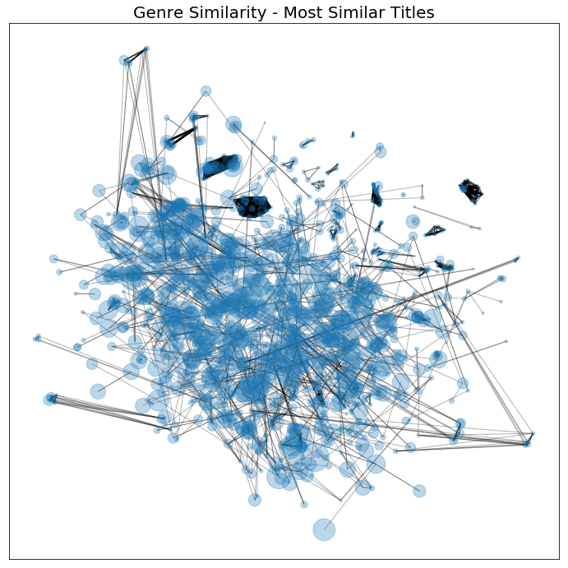
Evaluation: Proximity
How close are the most similar titles to each other?

Slide 13
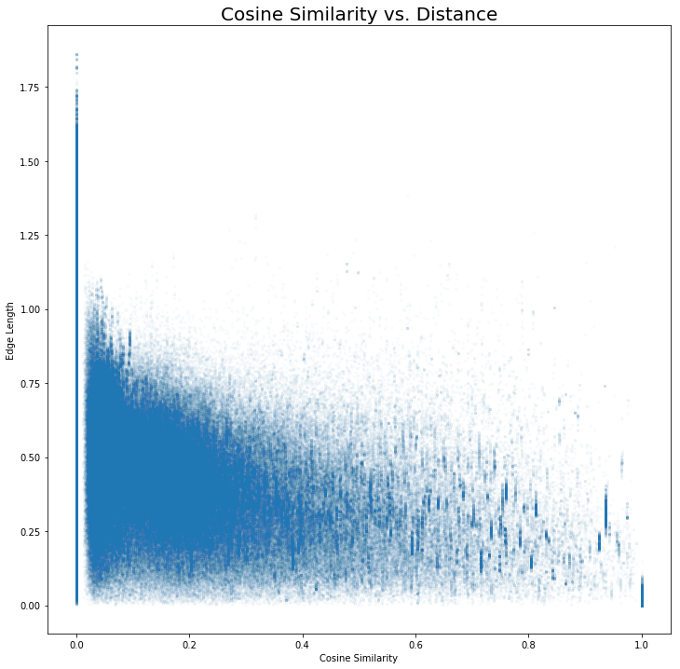
Evaluation: Proximity
How strong is the relationship between pairwise cosine similarity and graph node distance?

Slide 14
What Next?
Genre similarity as a first-pass recommendation engine
Ratings and watch history data available in this dataset
Mapping viewer demographics and viewing profiles
Is there a better way to evaluate the ‘quality’ of a genre map?
Was this actually an improvement over simply counting shared genres?
How strong are genre preferences?
How much do users’ viewing profiles tend to vary from the ‘average’ genre distribution?
Does ‘genre trash’ exist?

